Slide 1


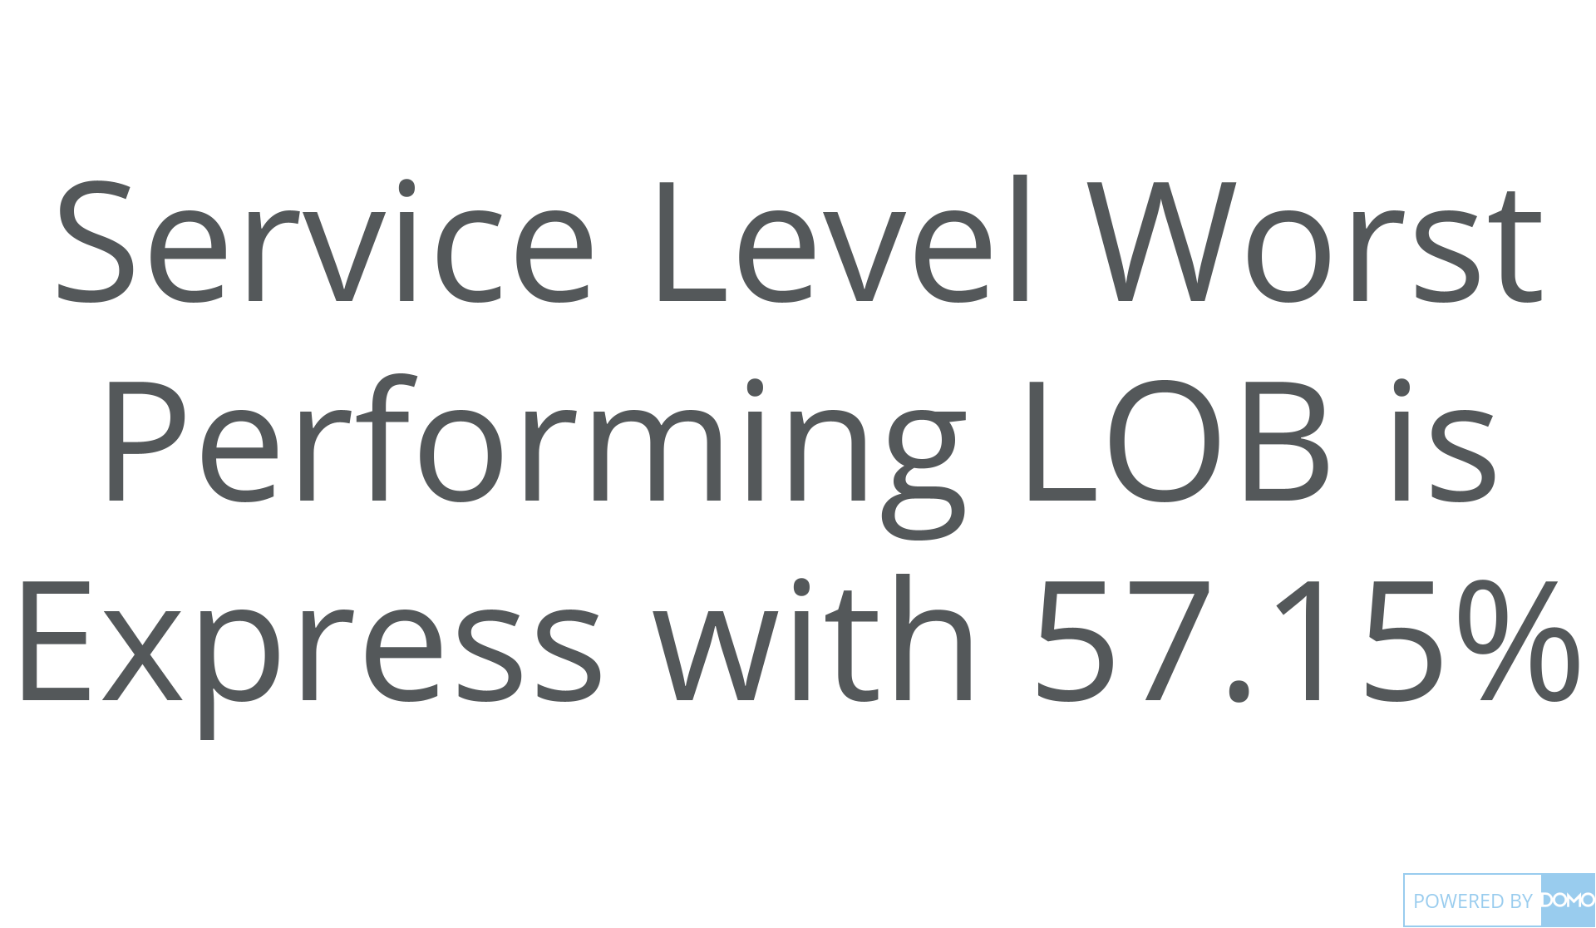
+
exported May 17, 2025, 12:37:00 PM UTC
PE 1 | CARD 10 |Worst Performing LOB
Jan 1, 2023 - Dec 31, 2025

